Slide 1
N-uwu Thinking, N-uwu Directions: The Fursona and Furry Media
Reuben Mount / Vanguard Husky
3rd year PhD

Slide 2
What the fluff?

Slide 3
'Furry fans are individuals who self-identify with an interest in anthropomorphism—the ascription of human traits to animals—and zoomorphism—the ascription of animal traits to humans'.
Reysen, et al. (2017)

Slide 4
'A fursona is a furspeech portmanteau derived from the terms furry and persona, that refers to a (normally furry) character, persona, alter ego, avatar, or identity assumed by a person or player normally associated with the furry fandom'.
WikiFur (2024)

Slide 5
Fursonas and furry media
… where I arrive to bork things up.

Slide 6
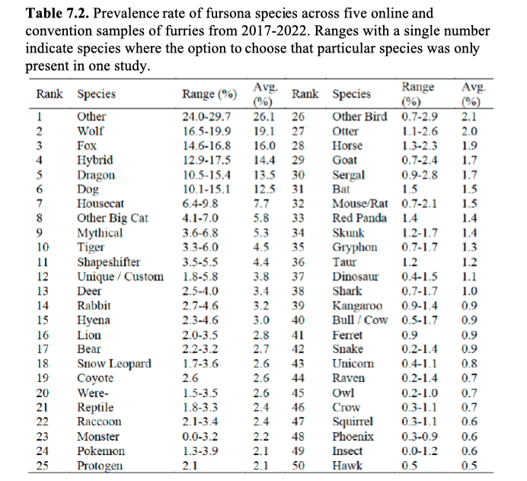
Fursona species choice is overwhelmingly canine (Plante, 2023)

Slide 7
Who started the howl?
Examination of two furry texts for prevalence of canine furry characters

Slide 8
Housepets! (2008)
Primary characters: dog and housecat (6th and 7th respectively).
Largest proportion of named cast are canine – dogs, wolves and foxes (6th, 2nd and 3rd).
"Screen time" has 70% of top ten characters by appearance from canine species.

Slide 9
Robin Hood (1973)
Protagonist and love interest are foxes (3rd in demographic data).
Main antagonists are lion and wolf (8th and 2nd respectively).
Bears, rabbits and dogs also feature heavily and all from top 20 in data.

Slide 10
Who started the howl?
Furry Character in Media
Enters Fandom
Inspires Fursona
Artwork Created
Did the media inspire the furry or the furry inspire the media?

Slide 11
References:
Plante, C.N., Reysen, S., Adams, C., Roberts, S.E. and Gerbasi, K.C. eds. (2023) Furscience: A Decade of Psychological Research on the Furry Fandom, International Anthropomorphic Research Project: Texas.
Reysen, S., Plante, C., Roberts, S., Gerbasi, K., Schroy, C., Gamboa, A., Gamboa, J., and McCarter, T. (2017) Routes to Fandom Discovery and Expression of Fan Identity in Furry, Anime, and Fantasy Sport Fans, The Phoenix Papers, 3(1), pp.373-384.
WikiFur (2023) WikiFur, the furry encyclopaedia [online]. Available at <https://en.wikifur.com/wiki/WikiFur> [Accessed 6th February 2024].

Slide 12
Thank you!
Reuben Mount / Vanguard Husky
3rd year PhD

